Slide 1

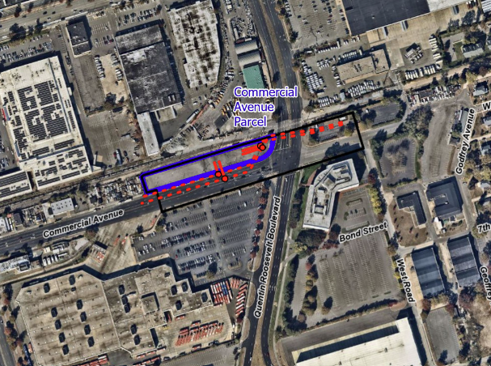
Commercial Avenue Equipment Project
PSEG Long Island is committed to delivering best-in-class system reliability by expanding electrical capacity to meet the energy needs of the communities it serves, today and in the future.
Project Overview & Benefits
PSEG Long Island, as the agent of LIPA, is filing an application for an amendment to an existing Article VII certificate for Transmission Line 138-463 and a modification to Transmission Line 138-462. The Commercial Avenue Equipment Project would include the installation of new substation equipment on LIPA-owned property, on the northwest corner of Commercial Avenue and Quentin Roosevelt Boulevard in Uniondale. Existing lines will be rerouted to tap into and out of the new substation equipment at the Commercial Avenue site.
Benefits Include:
The new equipment at the Commercial Avenue site will help ensure continued reliable electric service to the area and Long Island.
The Project will utilize existing manholes, and the modified electric transmission lines will be located primarily under roads and within LIPA rights-of-way.
Project Area:
Permitting & Consultation Process
To construct the Project, PSEG Long Island will need, in addition to other necessary permits:
The New York State Public Service Commission's issuance of an amendment to the Article VII Certificate of Environmental Compatibility and Public Need and approval of an Environmental Management & Construction Plan (EM&CP).
Approval from or consultation with the New York Department of Environmental Conservation, and New York State Office of Parks, Recreation & Historic Preservation.
Consultation with Nassau County and Town of Hempstead.
New York State Public Service Commission Article VII Information
After the Project's amendment application is filed and the Commission assigns a case number to the Project, the case number will be provided on the Project's website. Then, the amendment application and related case documents can be accessed on the PSC website (www.dps.ny.gov) by clicking "File Search" and filling in the case number. This will bring up the main Document and Matter Management (“DMM”) page(s) for this case, where the materials are located.
In addition, interested persons who wish to participate as parties in this case may file for party status. On the DMM page for this case, the prospective party should click the button at the upper right labeled “Request for Party Status” to see a Public Service Commission web page with instructions for the procedures to follow to become a party.
For Questions About the Commercial Avenue Equipment Project,
Call or Text 631-213-6715 Email info@CommercialAveEquipment.com Visit www.CommercialAveEquipment.com

